Slide 1

Household electric power consumption
Maria Fernanda Ribeiro

Slide 2
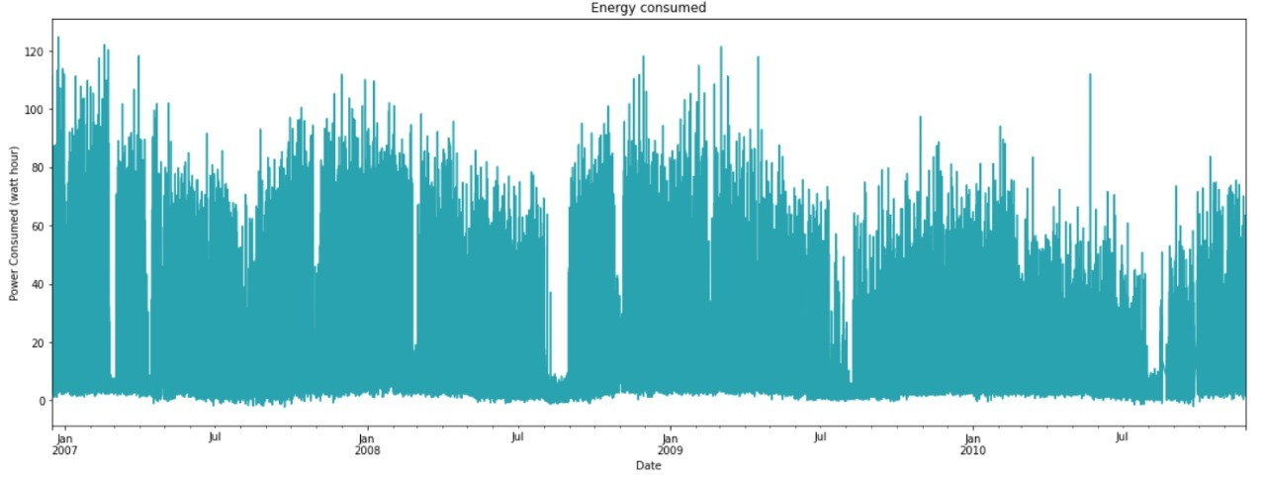
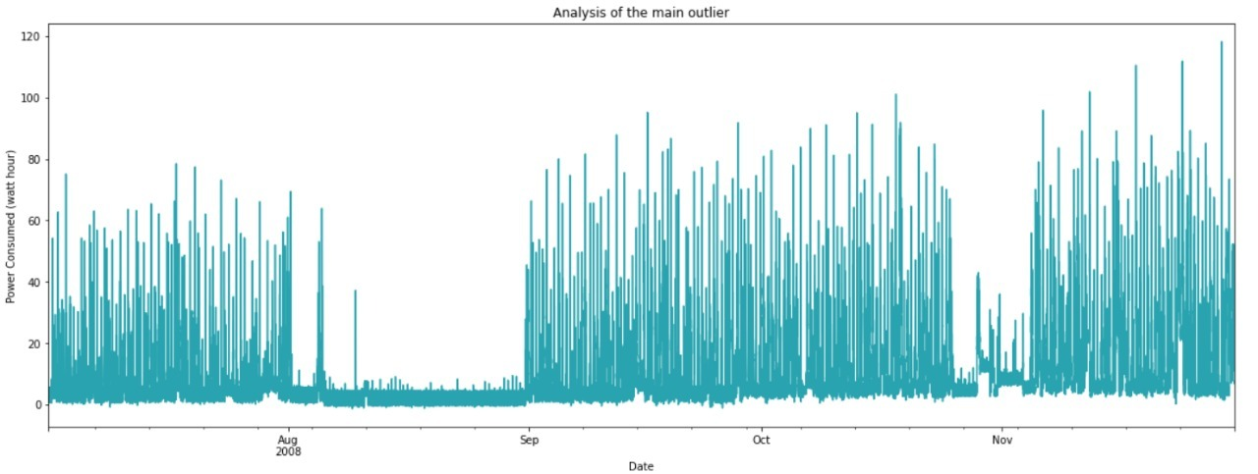
Exploratory Data Analysis
Number of data: 2075259
Number of features: 9
New feature created - energy consumption (watt-hour)
Datetimes with missing values: 25979
Missing Data ( Nan, ? and Null) treated with interpolation of data
Outliers happen frequently between august and september

Slide 3


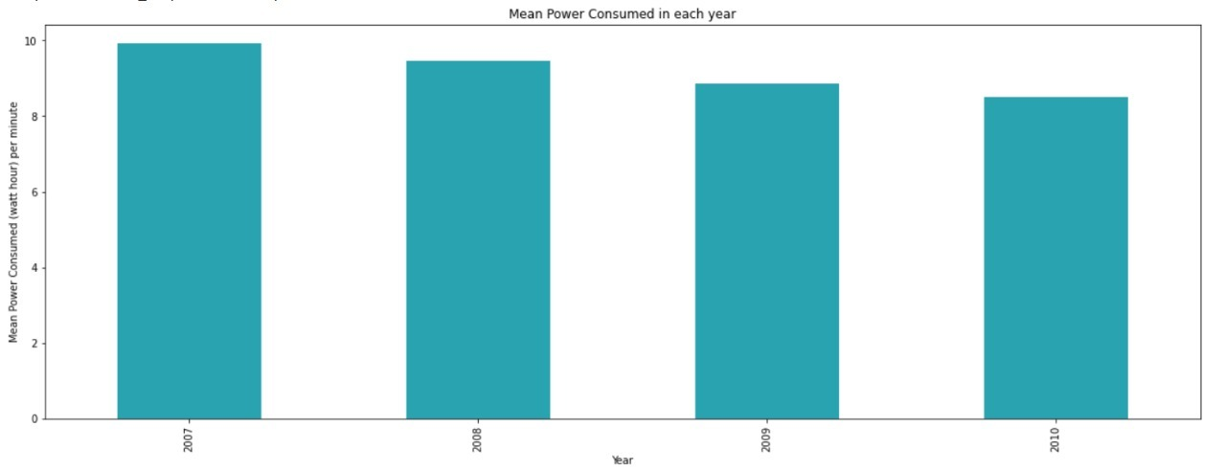
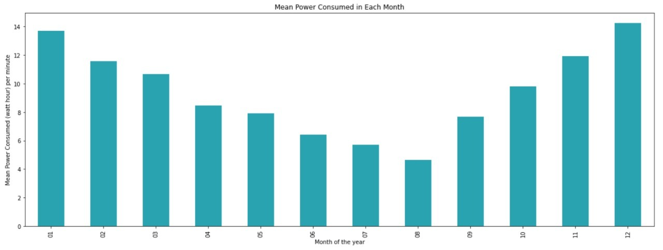


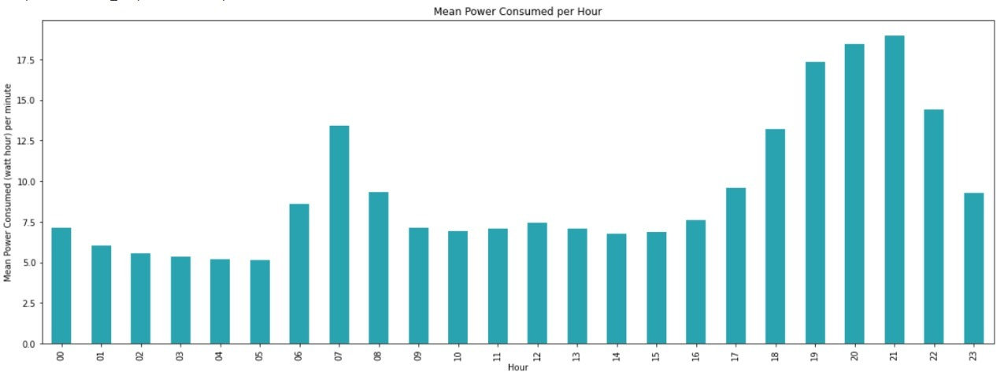
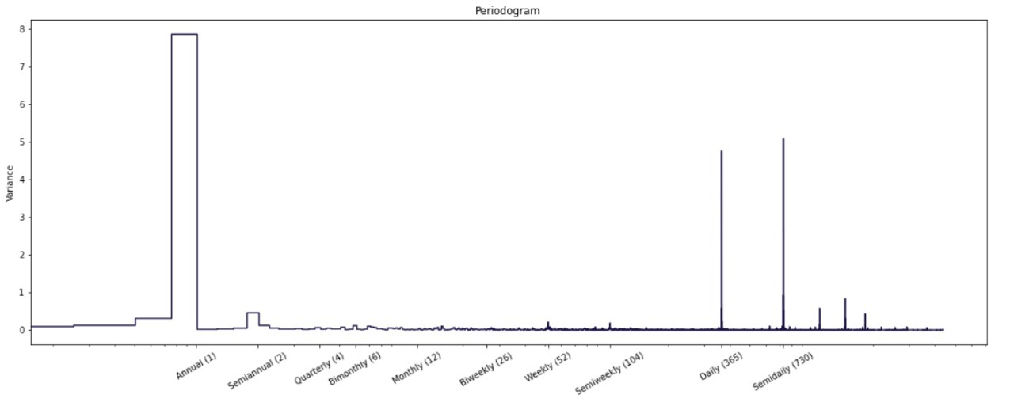
Key Findings
Mean Power consumption is decreasing each year
Power consumption is greater at Winter
Power consumption increases before and after working hours
Seasonality annual and daily

Slide 4

Business Problem
An electrical company has capital that can be invested in new infrastructure. It is essential to know the consumption of each area and if there is a tendency for growth or decay in their power consumption to make the best decision of the scarce capital.
Also, it is essential to verify growing trends when the consumption achieves critical values for the current electrical grid network to plan the infrastructure delivery.
An analyst suggests that the company can use the data of one house to do the preliminary analysis and, once the analysis hypothesis get approved, they will apply it the whole area.
With this dataset you can analyse consumptions trend; time of day and period of year with more power consumptions and family habits as time of shower and sleep hours.

Slide 5
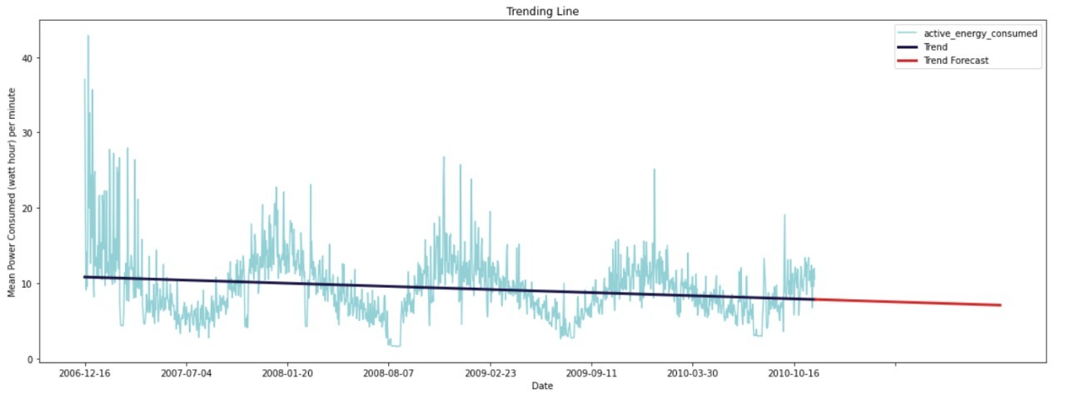
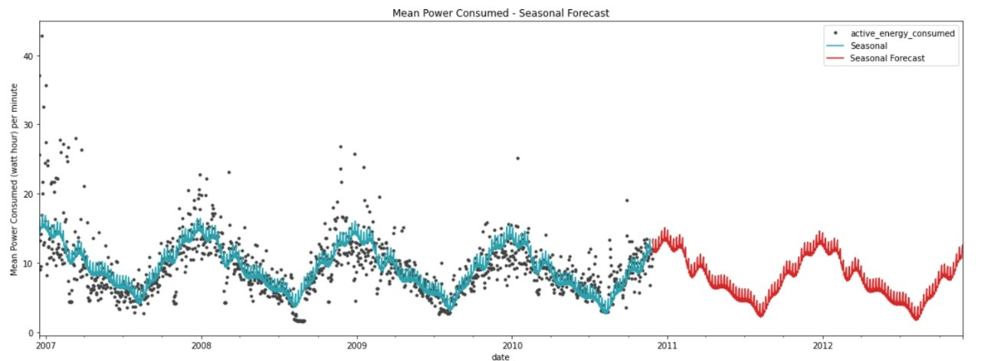
Modeling
Rolling Average used in order to track the behavior (blue line).
Linear Regression made after the rolling average to obtain the trending line
It is noticeable that the power consumption is decreasing with time
Include your modeling approach
Seasonal Forecast made after Fourier Series, for deterministic terms ( using calendar time)
With it you can see the trend for the next two years (granularity level of days)

Slide 6
Thank you
Maria Fernanda Ribeiro

